Slide 1

HOTEL DOMAIN ANALYSIS
Presented by
Shailaja Sirumalla

Slide 2

DELHI
MUMBAI
BANGALORE
HYDERABAD

Slide 3
Problem statement :
Atliq Grands encountered tough competition and a
decline in revenue. They sought to utilize data and
strategic insights but lacked internal expertise.
My aim is to conduct a comprehensive analysis using
Python to empower Atliq Grands with insights for
customer retention and revenue growth.

Slide 4
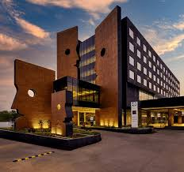
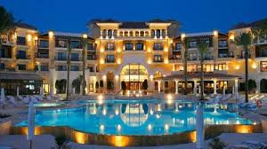
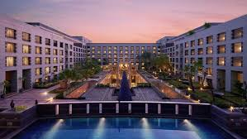
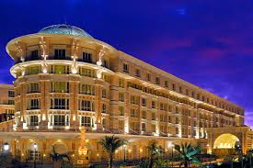
Atliq Seasons
Atliq Exotica
Atliq Bay
Atliq Palace

Slide 5
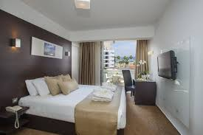


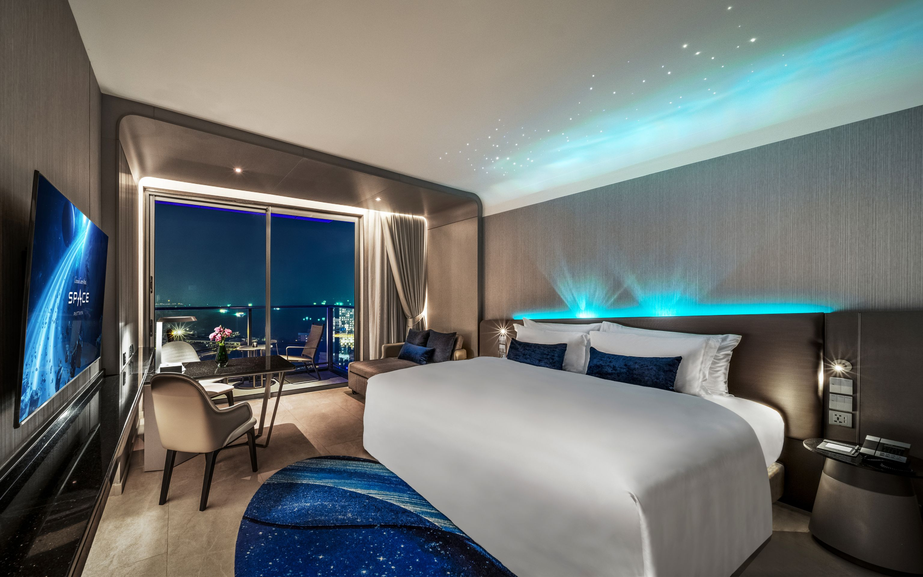
Standard
Elite
Premium
Presidential

Slide 6
These are the steps I performed:
DATA EXPLORATION
DATA CLEANING
DATA TRANSFORMATION
INSIGHTS GENERATION

Slide 7
Insights Generation :
Revenue Insights
Top Earning City: Mumbai led in revenue with 669M INR, while Delhi lagged at 291M INR.
Best Month: May generated the highest revenue (581.93M INR), while June was the lowest (553.93M INR).
Popular Room Category: Elite rooms brought in the most revenue, hitting 553.74M INR.
Customer Experience Highlights
Highest-Rated Room: Guests loved the Presidential rooms the most, rating them at 3.69. Premium rooms got the lowest rating at 3.59.
City with Best Ratings: Delhi stood out with an average rating of 3.78, showing guests had a great experience.
Occupancy & Booking Trends
Occupancy Leader: Delhi not only excelled in ratings but also had the highest occupancy at 62.47%.
Weekend Rush: Weekends, especially Fridays and Saturdays, saw more bookings, hinting at an opportunity for targeted promotions.

Slide 8
Thank You

